Slide 1
Travel Diaries
A Project on SQL

Slide 2
Introduction
The aim of the Travel Diaries project is to encourage a sense of community among travellers, inspire wanderlust, and provide a centralized platform for preserving and sharing travel memories. Whether users are globe-trotting adventurers or weekend explorers, Travel Diaries offers a virtual space to document and relive their travel experiences while connecting with like-minded individuals.

Slide 3
Structure of tables
The structure of the "Travel Diaries" table will depend on the specific database management system being used. This is a generalized structure for the "Travel Diaries" table, and additional columns may be added based on the specific requirements of the project.

Slide 4
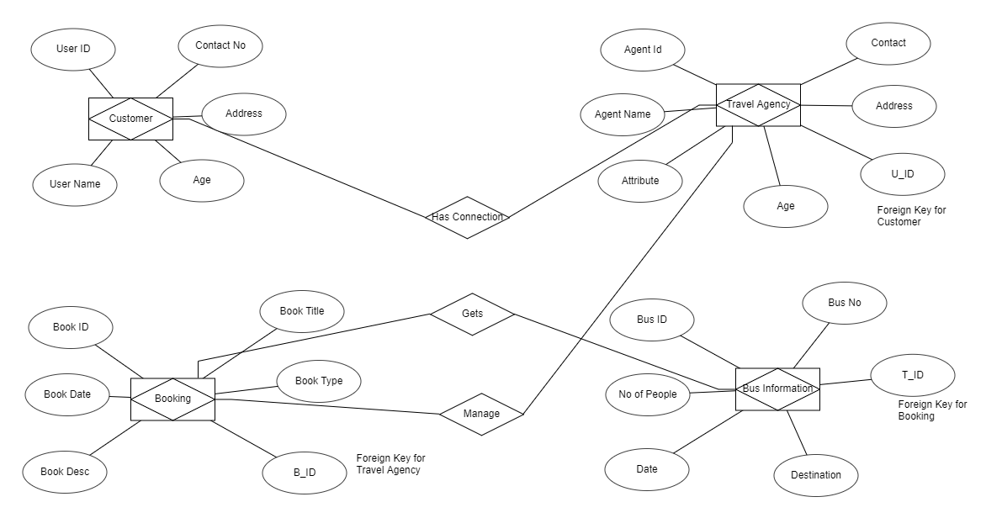
ER DIAGRAM OF THE PROJECT

Slide 5
TABLES USED IN THE PROJECT
CUSTOMER
BOOKING
TRAVEL AGENCY
BUS INFO

Slide 6
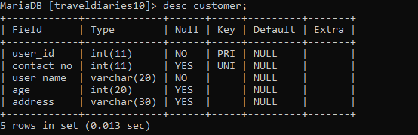
Customer
This Table shows the record of the customer.

Slide 7
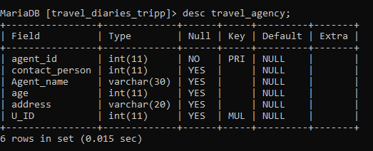
Travel agency
The "travel Agency" table stores information about various travel agencies.

Slide 8
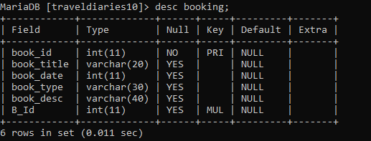
Booking
The "booking" table captures information about bookings made by customers. Each booking is uniquely identified by the booking ID column.

Slide 9
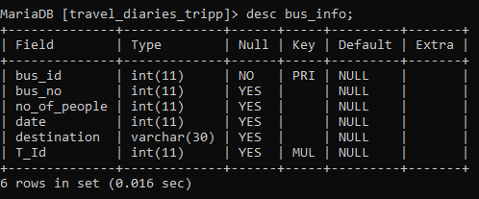
Bus info
The "bus" table stores information about different buses. Each bus is uniquely identified by the bus id column.

Slide 10
INSERTING VALUES INTO TABLES
DISPLAY THE VALUES WHICH ARE INSERTED INTO THE TABLES

Slide 11
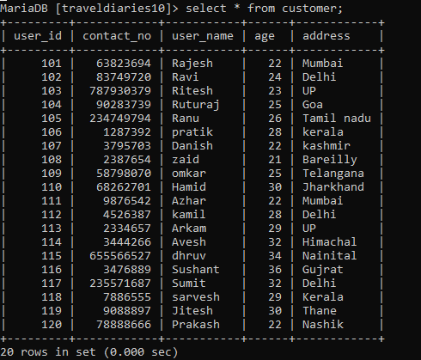
Customer

Slide 12
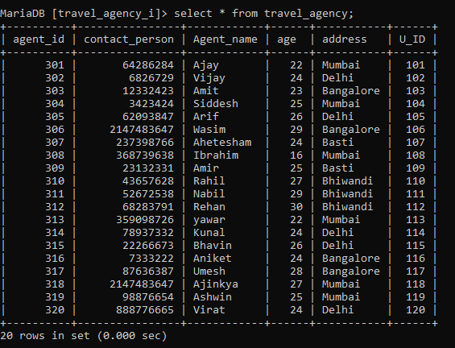
Travel Agency

Slide 13
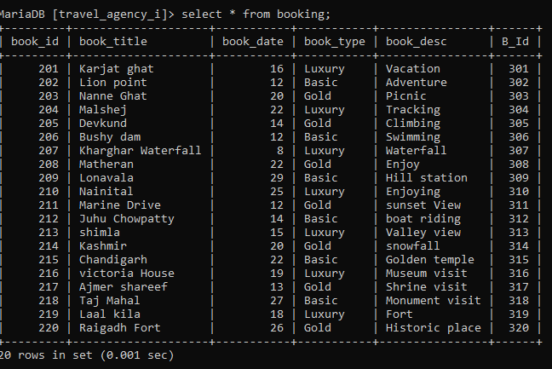
Booking

Slide 14
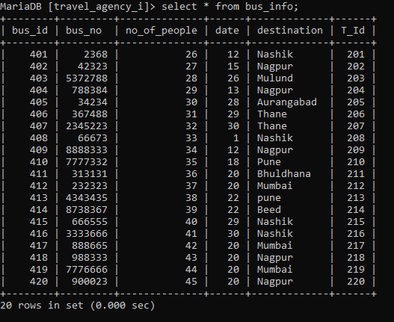
Bus Info

Slide 15

SUBQUERIES
Q. find the books with the highest number of book_date:
ANS = select * from booking where book_date = (select max(book_date) from booking);

Slide 16

Q.find the total number of people booking on bus info ?
ANS= select bus_no from bus_info where no_of_people > 30;

Slide 17

Q.Find the maximum book date from booking
select book_id from booking where book_date > 20;

Slide 18
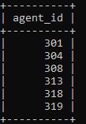
Q. find the agents who have booked buses to Mumbai
ANS = select agent_id FROM travel_agency where address = 'mumbai';

Slide 19
JOINS

Slide 20
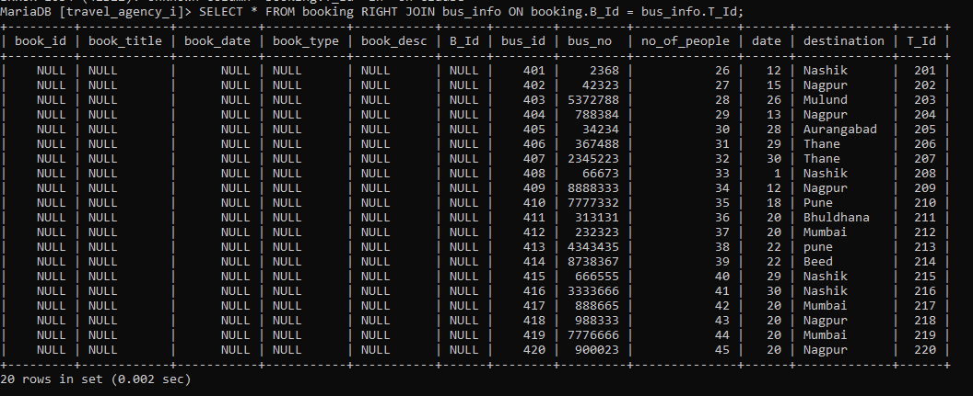
RIGHT JOIN TO RETRIEVE TRAVEL INFORMATION ALONG WITH COREESPONDING CUSTOMER DETAILS
Select * from booking RIGHT JOIN bus_info on booking.B_ID=bus_info.T_id;

Slide 21
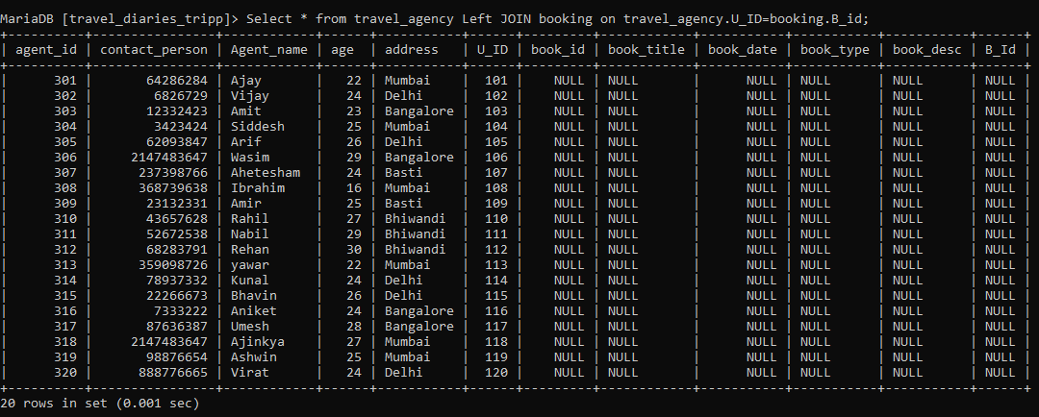
LEFT JOIN TO RETRIEVE TRAVEL INFORMATION ALONG WITH CORRESPONDING CUSTOMER DETAILS
Select * from travel_agency LEFT JOIN booking on travel_agency.U_ID=booking.B_id;

Slide 22
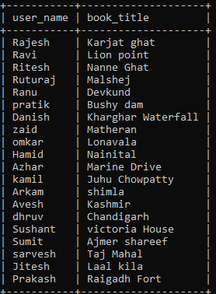
INNER JOIN TO RETRIEVE TRAVEL INFORMATION ALONG WITH COREESPONDING CUSTOMER DETAILS
select u.user_name, b.book_title from customer u inner join booking b on u.user_id = b.B_Id;

Slide 23
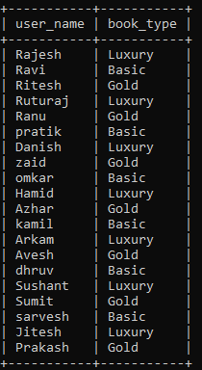
LEFT JOIN TO RETRIEVE TRAVEL INFORMATION ALONG WITH COREESPONDING CUSTOMER DETAILS
select u.user_name, b.book_title from customer u left join booking b on u.user_id = b.B_Id;

